Slide 1


The North Central Texas Accelerator Session Model
Driving Workforce, Education and Economic Development Outcomes from Insight to Action

Slide 2
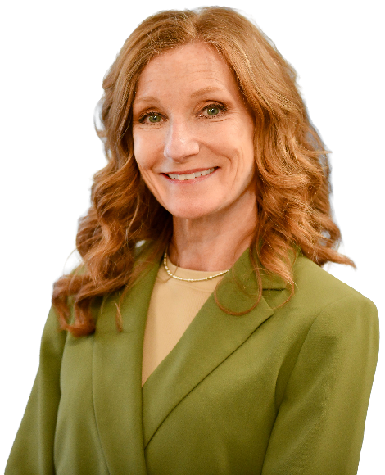
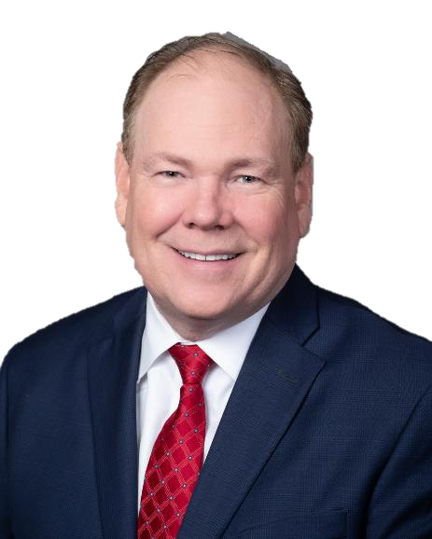

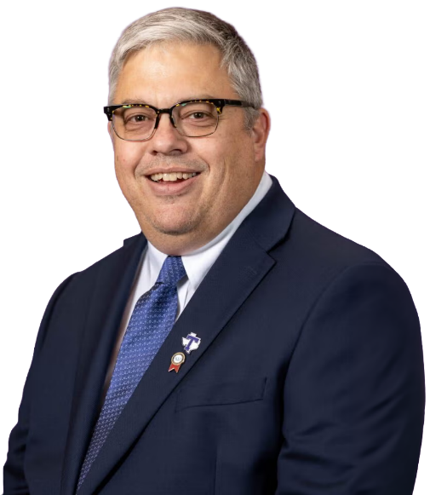
Panel Insights
Phedra Redifer
Executive Director
Workforce Solutions for North Central Texas
Andy Eads
Denton County Judge & Lead Chief Elected Official
Jan Jungman
Director of Business Retention & Workforce Development
Allen EDC
Dr. George Mollick
Associate Dean of Workforce Pathways and Career Development
Tarleton State University

Slide 3
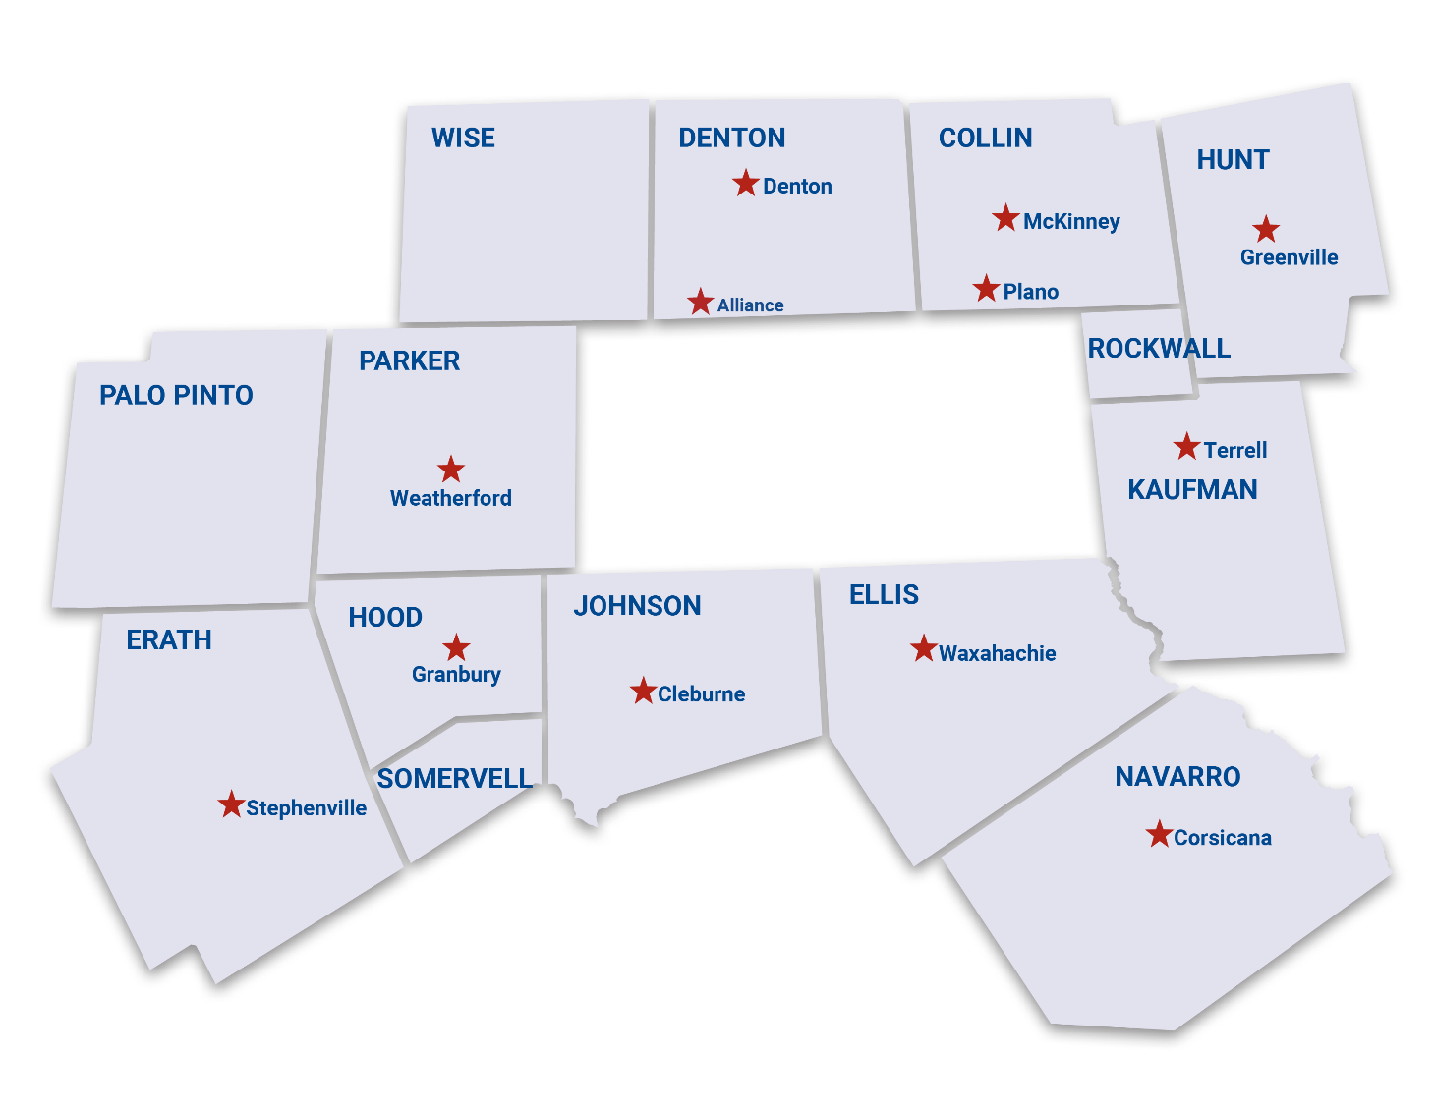
North Central Texas Workforce Development Board Area
We oversee programs to ensure that the businesses in our 14-county region remain competitive and grow jobs, that workers have opportunities to obtain skills and a career that will help them become or remain self-sufficient, and that our communities prosper and are economically resilient.

Slide 4




FY25 MILESTONES
80,000+
Career Seekers Served
7,800
Employers
Served
104
Hiring
Events
6,200 Veterans
10,400 Youth & Young Adults
7,600
690
Early Learning Program Providers Served
Children Received
Quality Child Care
21,500+ Hours of Mentoring & Coaching
276 Hours of Professional Development

Slide 5

Workforce is a Team Sport
Creating tighter linkages between workforce, economic development, education and community
Collaborating with our partners to generate positive outcomes for industry and individuals
Transforming the social and economic vitality of those we serve
Notes:
Workforce Development is a team sport.
It is no longer effective to operate in isolation or take a narrow view of workforce development’s role in helping to build our regional economy.
We realized this early on and have been finding new and deeper ways to engage with our customers and partners.
The key for the Accelerator Sessions was tapping into the immense knowledge and local wisdom of our Chief Elected Officials and bringing them into the ecosystem conversation.

Slide 6

The North Central Texas
Accelerator Sessions
Quickening the pace of how
we identify and address workforce and economic development opportunities.
Notes:
We launched what we call “Accelerator Sessions,” which are interactive and engaging in-person conversations with workforce, Chief Elected Officials, community leaders, economic development corporations and education institutions in each of our counties.
The goal is to quicken the pace of how we identify and address workforce and economic development opportunities.
They are proving to be very effective at the exchange of information and ideas, and as a catalyst for action.

Slide 7

Accelerator Session Blueprint
Customized two-way information exchange between WSNCT and each county’s stakeholders.
Build deeper connections with county-level partners
Assess how we can more effectively leverage our services to meet needs
Exchange local wisdom, innovative ideas and opportunities to help us work toward and achieve greater impact at the county level
Provide a baseline of current workforce and economic data to set the stage, then engage in a group discussion to uncover valuable insights and potential priority action items for each county
Notes:
The plan was to establish a foundation of awareness with county stakeholders about WSNCT and educate them on the type of services we offer.
We created customized packets of information that provided county-level labor market and economic data, as well as a comprehensive overview of what we have done and are doing in each county.
From there, our plan was to engage in a dynamic conversation of what we could do in that county to bring about a larger workforce and economic impact.
You’ve heard the saying about “the best laid plans,” right? Well…starting with our first Accelerator Session, we discovered that our blueprint created a foundation for other organizations to build upon as well.

Slide 8
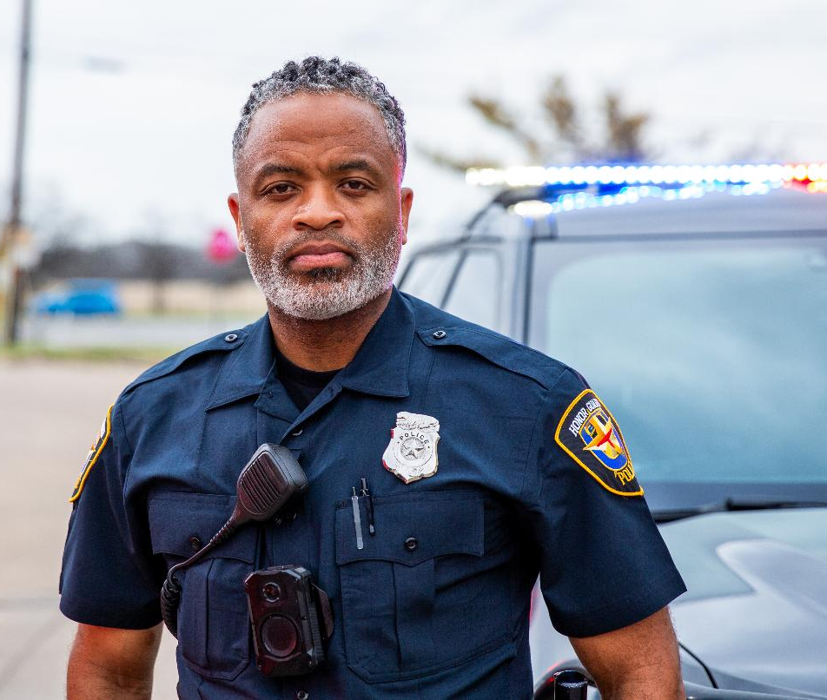
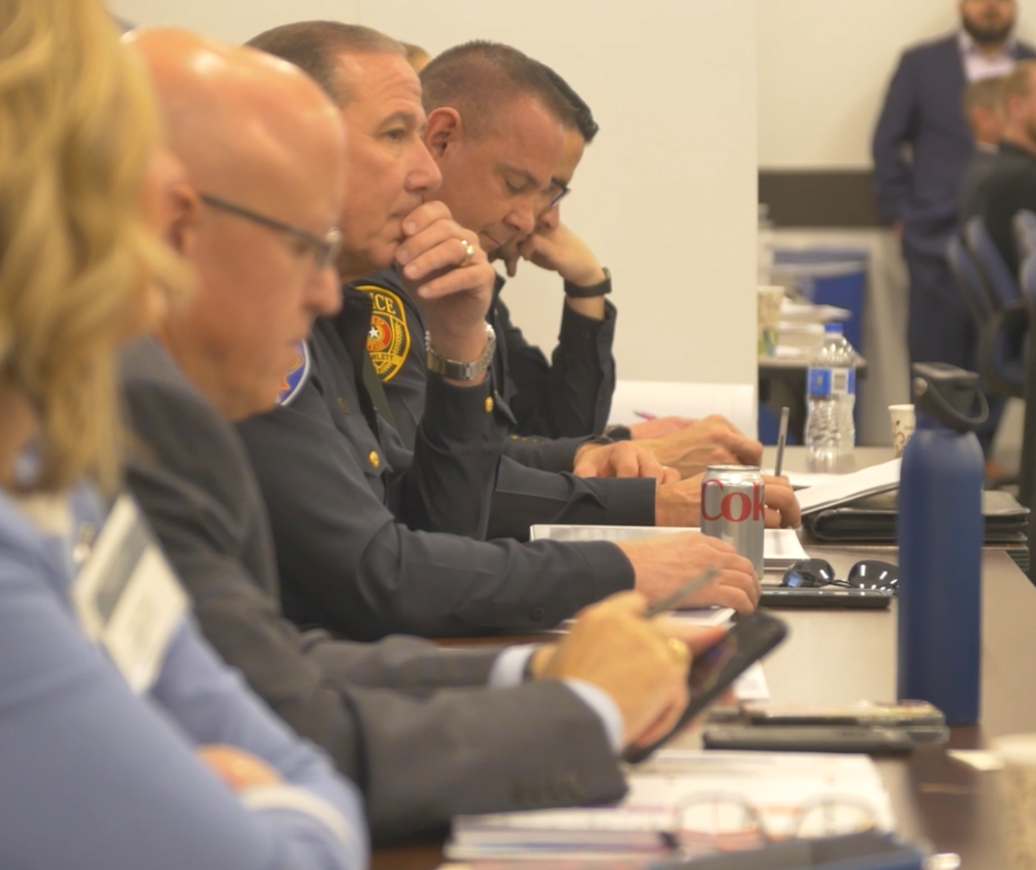
Strengthening Law Enforcement | Judge Andy Eads
Challenge Identified in Accelerator Sessions:
Significant need for law enforcement professionals, including sheriffs, police officers, correctional officers, jailers, and prosecutors’ office staff.
Rural counties face challenges competing with urban areas offering higher salaries and more resources.

Slide 9
Strengthening Law Enforcement | Judge Andy Eads
Accelerator Session Outcomes
Regional Law Enforcement Symposium:
  Convened 80+ law enforcement leaders, officers, and HR professionals to address recruitment, retention, and job design challenges.
$10M in Law Enforcement Grants:
  Secured funding through Texas Senate Bill 22 for 12 counties to hire deputies and investigators.
  Grants provided up to $500,000 for sheriff’s offices and $275,000 for prosecutor’s offices, ensuring critical positions are filled.

Slide 10

Supporting Foster Youth | Judge Andy Eades
Challenge Identified in Accelerator Sessions:
Foster youth face significant barriers to sustainable careers, particularly during the transition out of the foster care system.
Accelerator Session Outcomes:
“Path to Work” Foster Youth Guide:
  Developed as a result of Accelerator Session conversations to provide foster youth with clear pathways to sustainable careers.
  Focuses on empowering youth with resources and guidance for career success.
Collaborative Planning Efforts:
  Engaging area agencies, organizations, and workforce Board members to create impactful solutions for foster youth.

Slide 11

Data Dashboards & Employer Engagement | Jan Jungman
Challenges Identified through Accelerator Session:
  Labor market insights were difficult to analyze and required technical expertise, creating barriers for stakeholders like businesses, educators, and policymakers.
  Static reports and spreadsheets limited the ability to dynamically explore labor market trends, workforce demand, and career pathways.
  Stakeholders needed a user-friendly system to access and interpret data without requiring advanced technical skills.

Slide 12
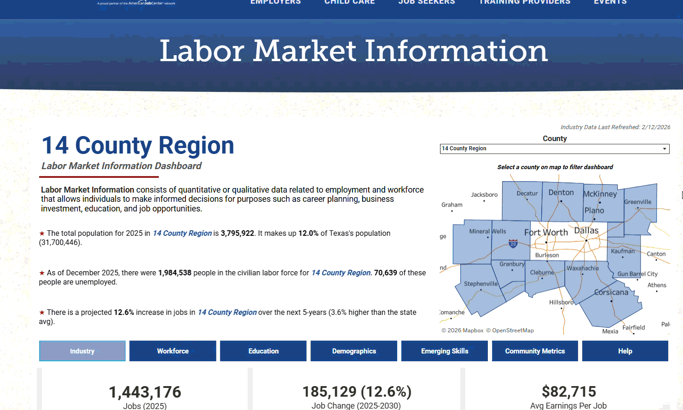
Data Dashboards & Employer Engagement | Jan Jungman
Accelerator Session Outcomes:
Interactive LMI Dashboards:
  Combines proprietary and public data into actionable insights for workforce planning and economic decision-making.
  User-friendly design allows non-technical users to access, analyze, and visualize labor market trends.
Strategic Employer Engagement:
  Helps employers identify workforce needs and align with regional strengths. Supports targeted job training programs based on labor market demand.

Slide 13
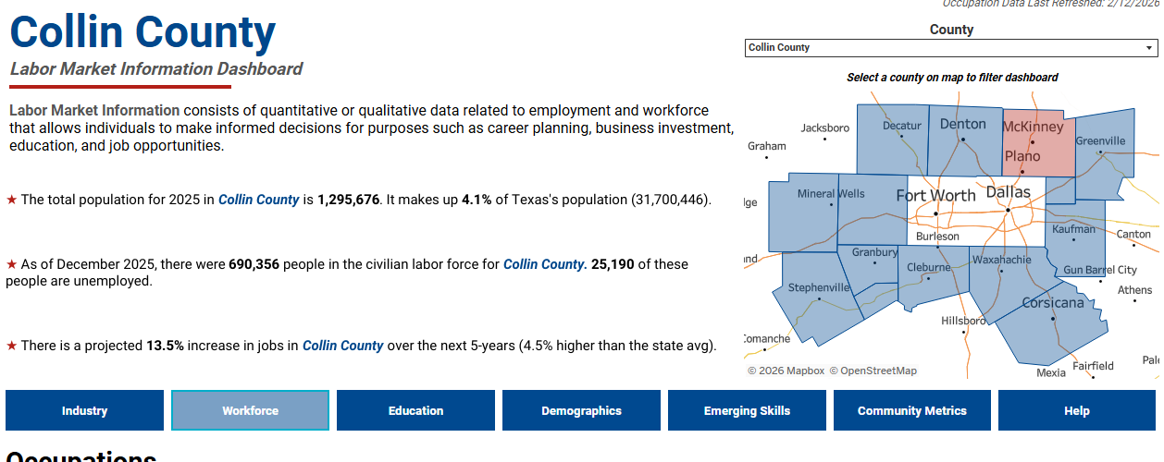

Slide 14
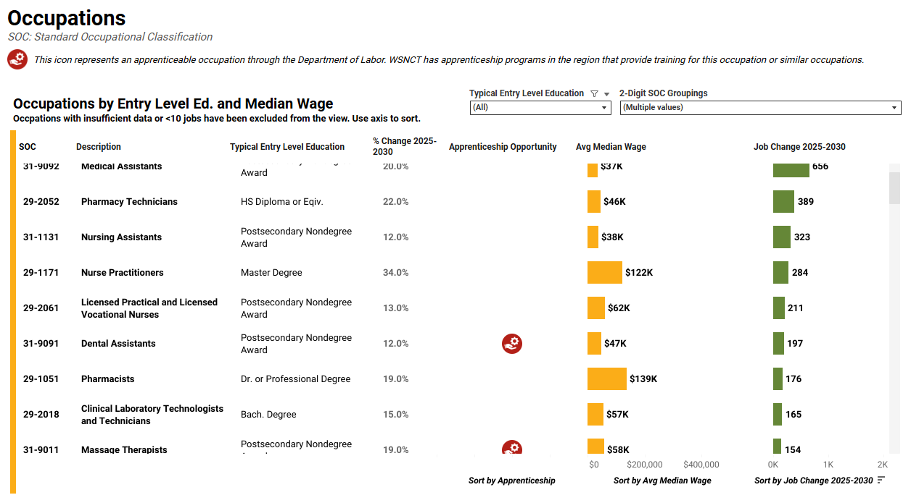

Slide 15
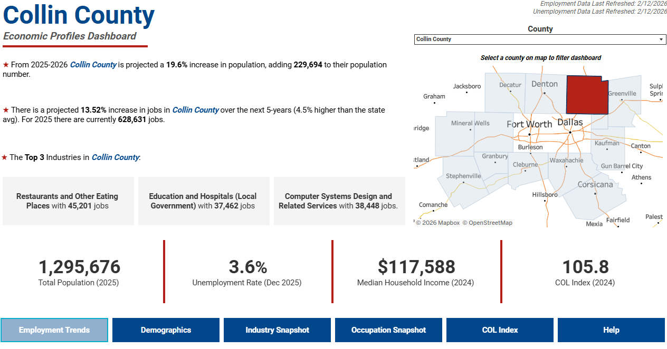

Slide 16
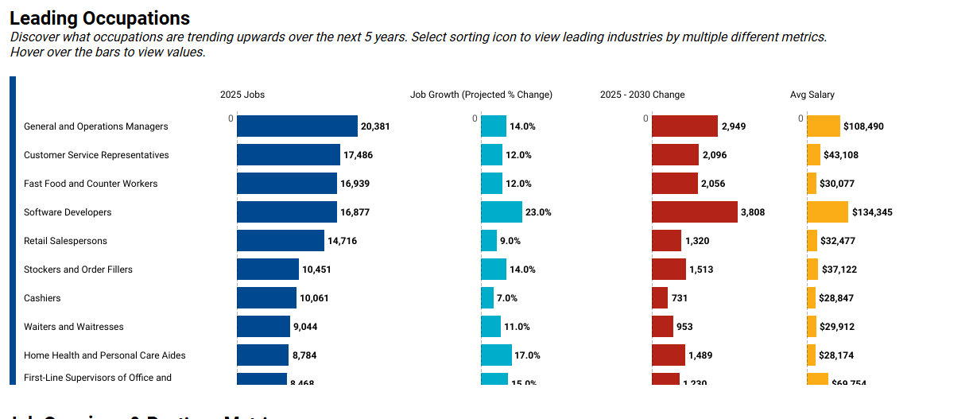

Slide 17
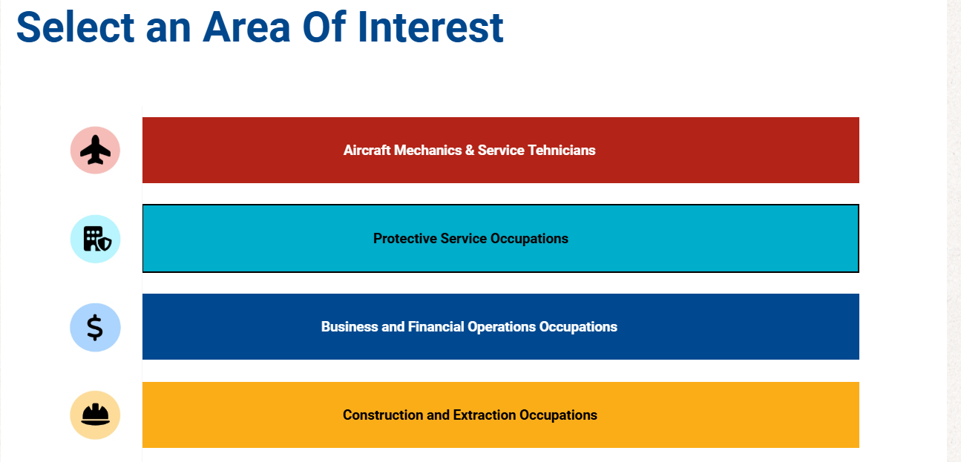

Slide 18

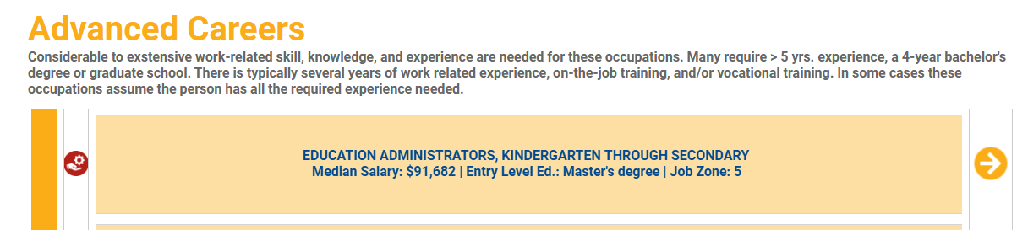

Slide 19

Streamlining Education Pathways | Dr. George Mollick
Challenges Identified in Accelerator Sessions:
Students faced significant challenges transferring credits between community colleges and universities, leading to delays and increased costs.
High school dual credit programs were not aligned with post-secondary institutions, creating inefficiencies and frustration for students.
Limited communication and collaboration between high schools, community colleges, and universities resulted in unclear pathways and missed opportunities for students to maximize their educational progress.

Slide 20

Streamlining Education Pathways | Dr. George Mollick
Accelerator Session Outcomes:
Collaboration with Educational Institutions:
  Partnered with Weatherford College and other community colleges to align dual credit programs, ensuring smoother transitions for students.
Acceptance of High School Certificates:
  Streamlined processes to accept certificates directly from high school transcripts, reducing unnecessary steps and accelerating student progress.
Improved Student Pathways:
  Created clear, predictable pathways from high school to community college to university, saving students time, money, and frustration.

Slide 21

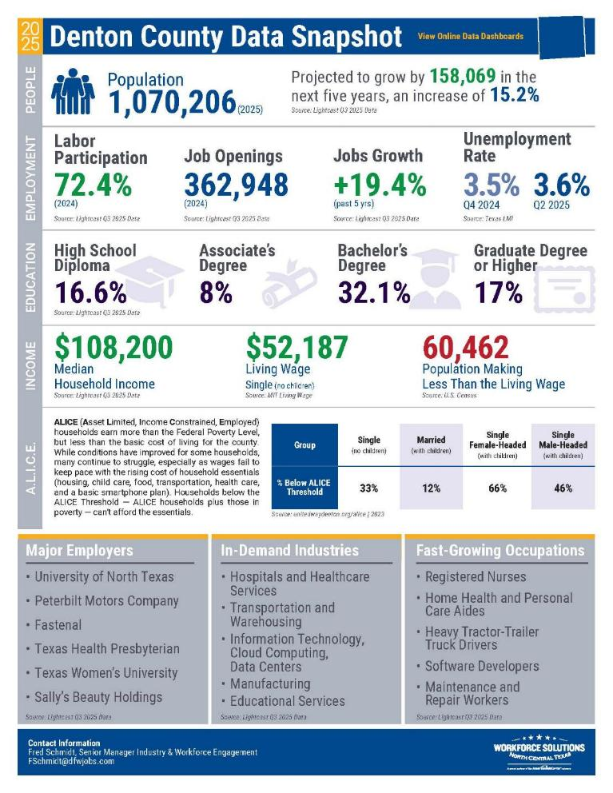

Accelerator Session Resources
Planning Template
Denton County Data Snapshot
Activity Tracker
Regional Insights & Impact Report

Slide 22
Thank You!

